Slide 1
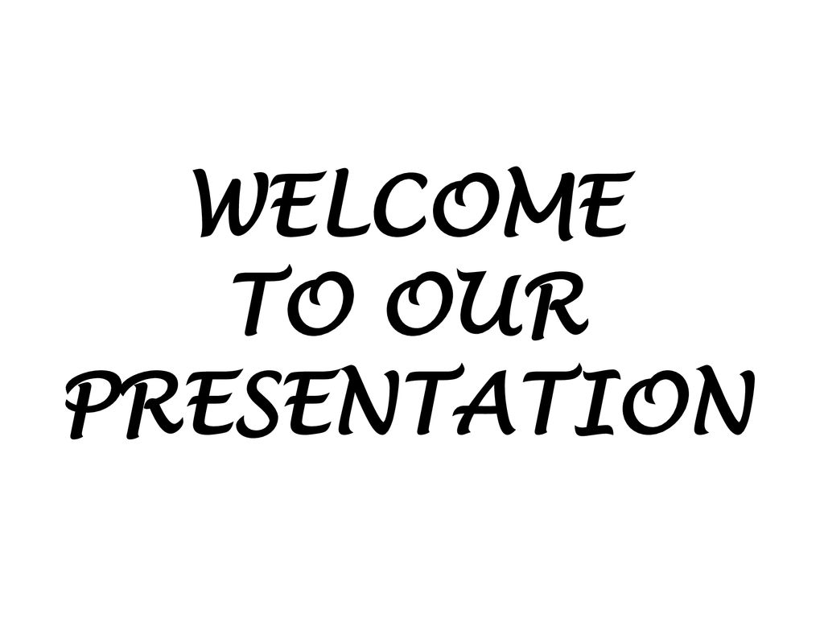


Slide 2

Group members:
Tamanna Akter: 221-15-5298
Mahmudul Hasan: 221-15-6013
Samit Aqib: 221-15-5159
Muktadir Hossain Shuvo: 221-15-5670
Md Mehedi Hasan Nayeem: 221-15-5049

Slide 3

ALGORITHM DESIGN AND ANALYSIS

Slide 4
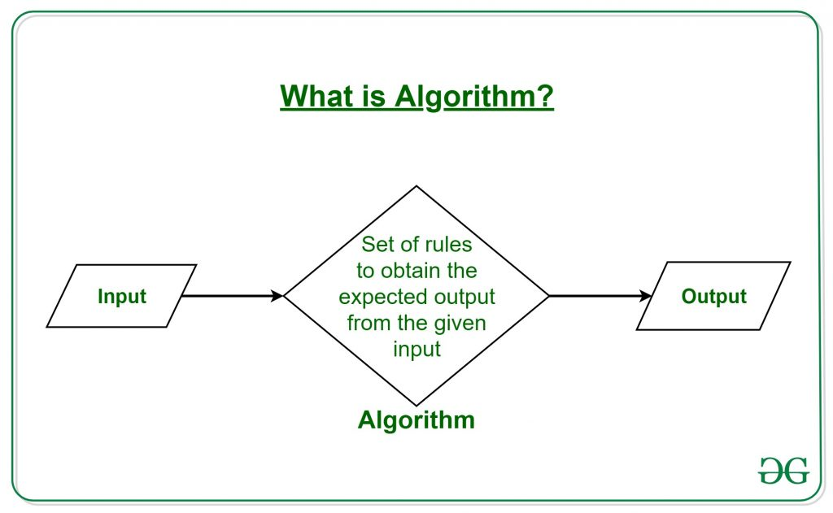
Algorithm is a step-by-step procedure to solve any Problem .

Slide 5
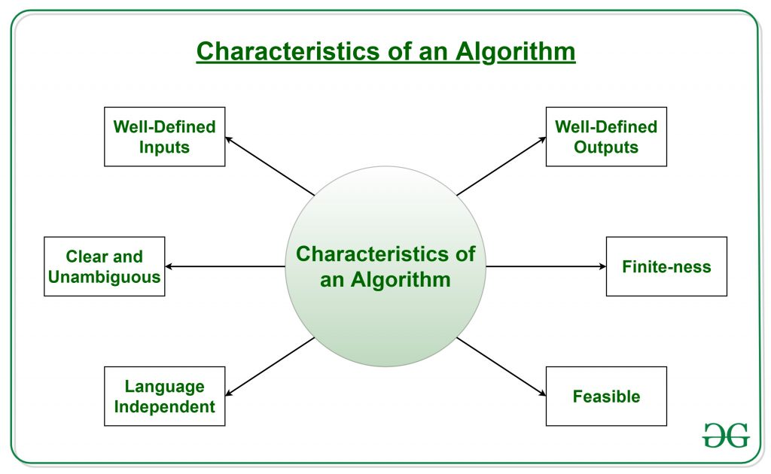

Slide 6
Methods of Specifying an Algorithm:
⚫ Pseudo code:
A mixture of a natural language and programming language.
⚫ Flowchart:
A method of expressing an algorithm by a collection of connected geometric shapes containing descriptions of the algorithm's steps.
⚫ Programs:
Another way of specifying the algorithm

Slide 7
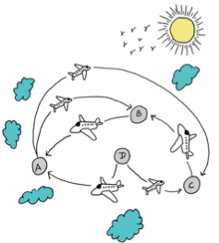



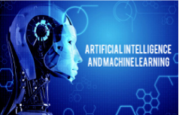
Real life example

Slide 8

Different types of Algorithms:
1. | Searching Algorithms
2. | Sorting Algorithms
3. | Divide and conquer algorithms
4. | Recursive algorithms
5. | Backtracking algorithms
6. | Brute force algorithms
7. | Greedy Algorithms
8. | Dynamic programming algorithms

Slide 9

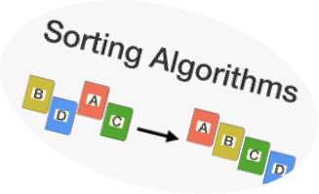
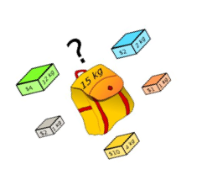
Application of Algorithms:
1. Searching Data
2. Sorting Data
3. Find out the Shortest Path
4. Best Possible solution

Slide 10
How to Write an Algorithm?
▪ There are no well-defined standards for writing algorithms.
▪ Rather, it is problem and resource dependent.
▪ Combination of human Language and Programming Language, so that it is easily understandable even by non-programmers.
▪ Algorithms are never written to support a particular programming code.

Slide 11
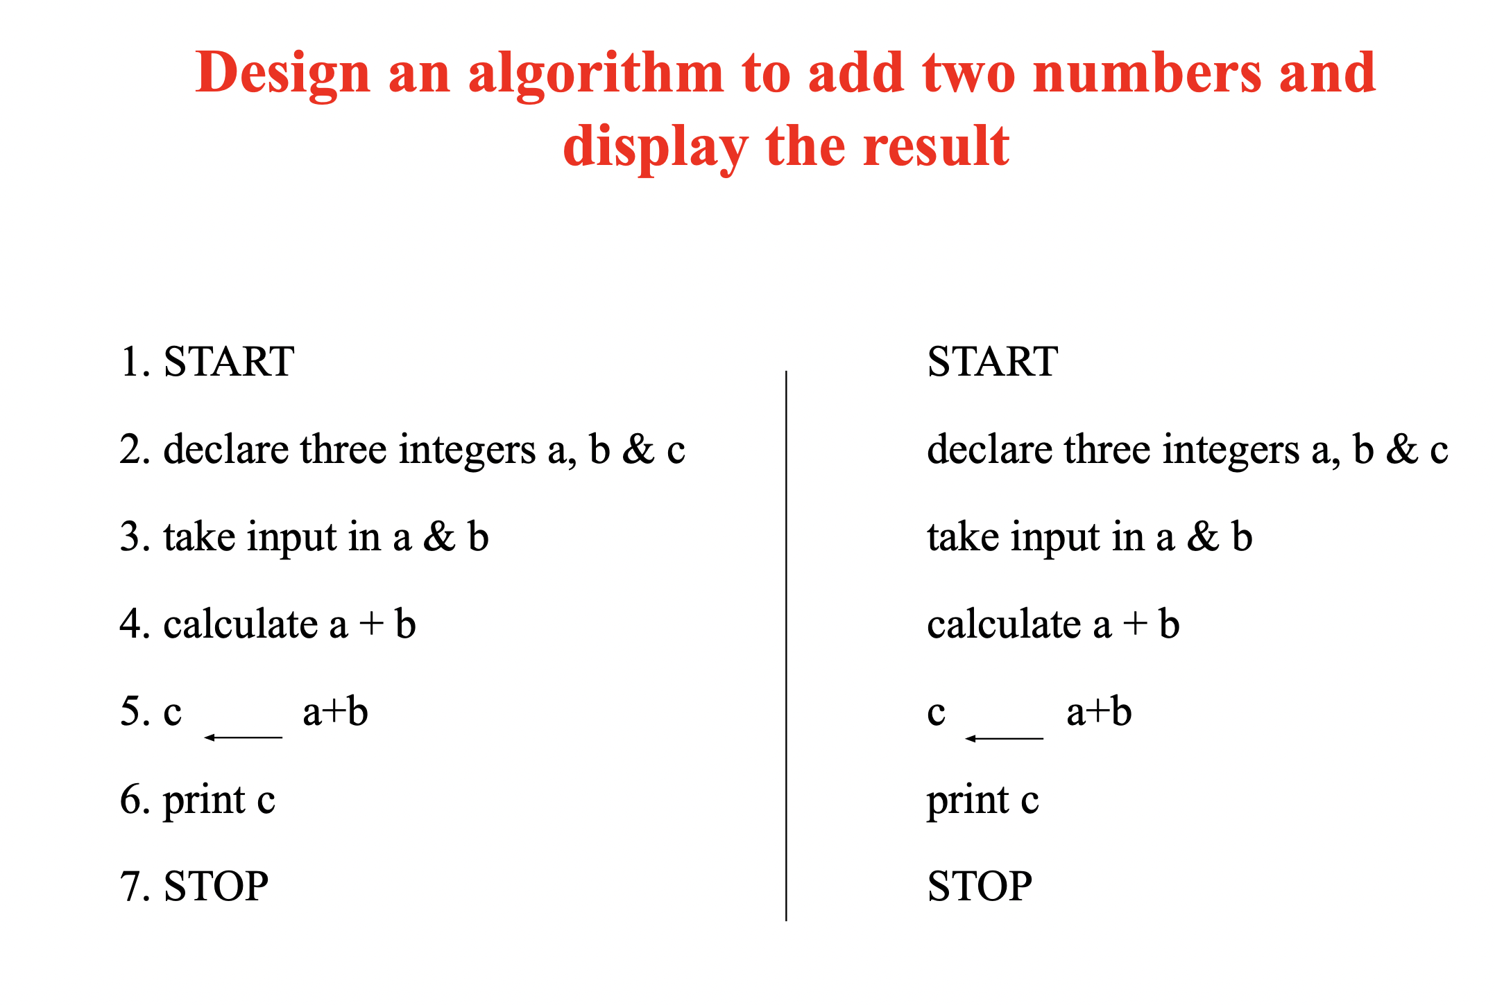
Example:

Slide 12


Methods for analysing Algorithms
1. Correctness .
Time Complexity
Space Complexity

Slide 13
Understanding of Time and Space Complexity
Design an algorithm to add two numbers and display the result
Algo-1:
1. START
2. declare three integers a, b & c
3. Input in a & b
4. c = a + b
5. print c
6. STOP
Time = 6sec
Space =12 Bytes

Slide 14
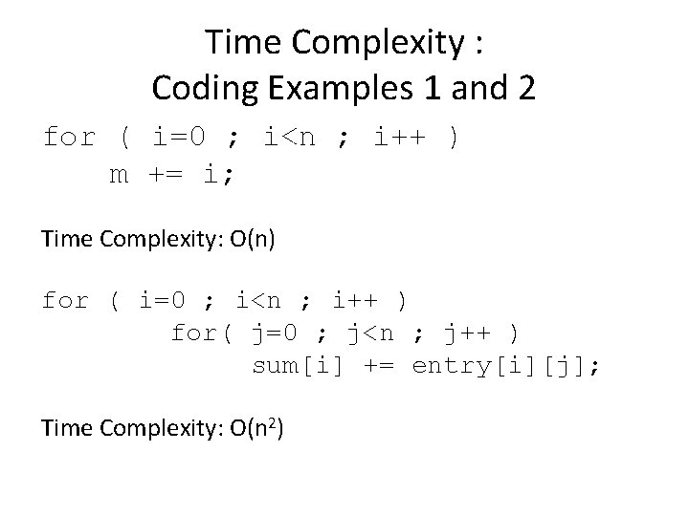

Slide 15
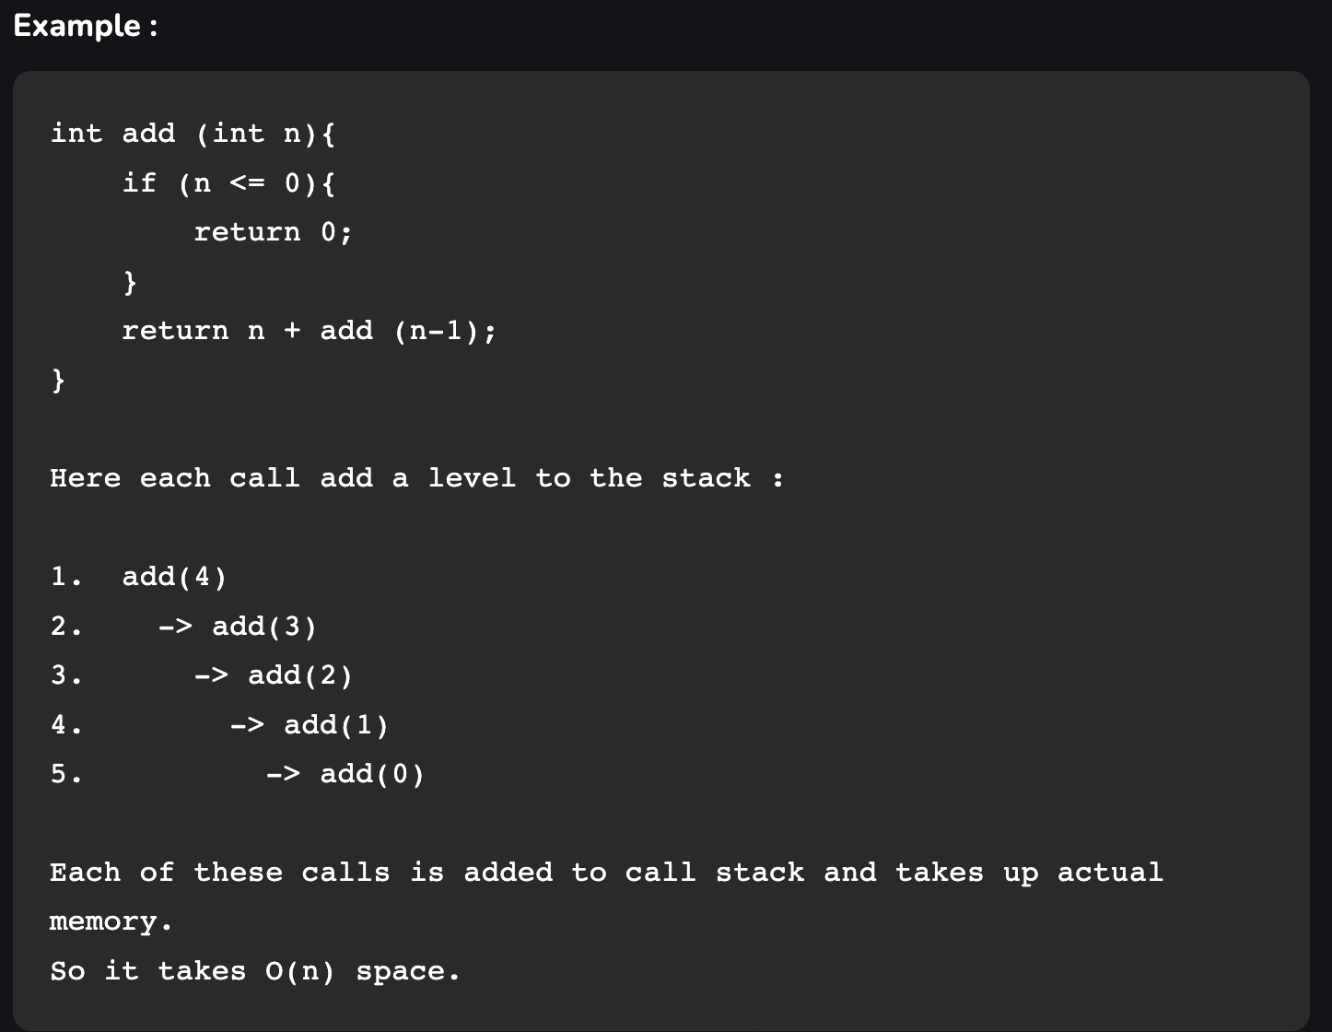

Slide 16
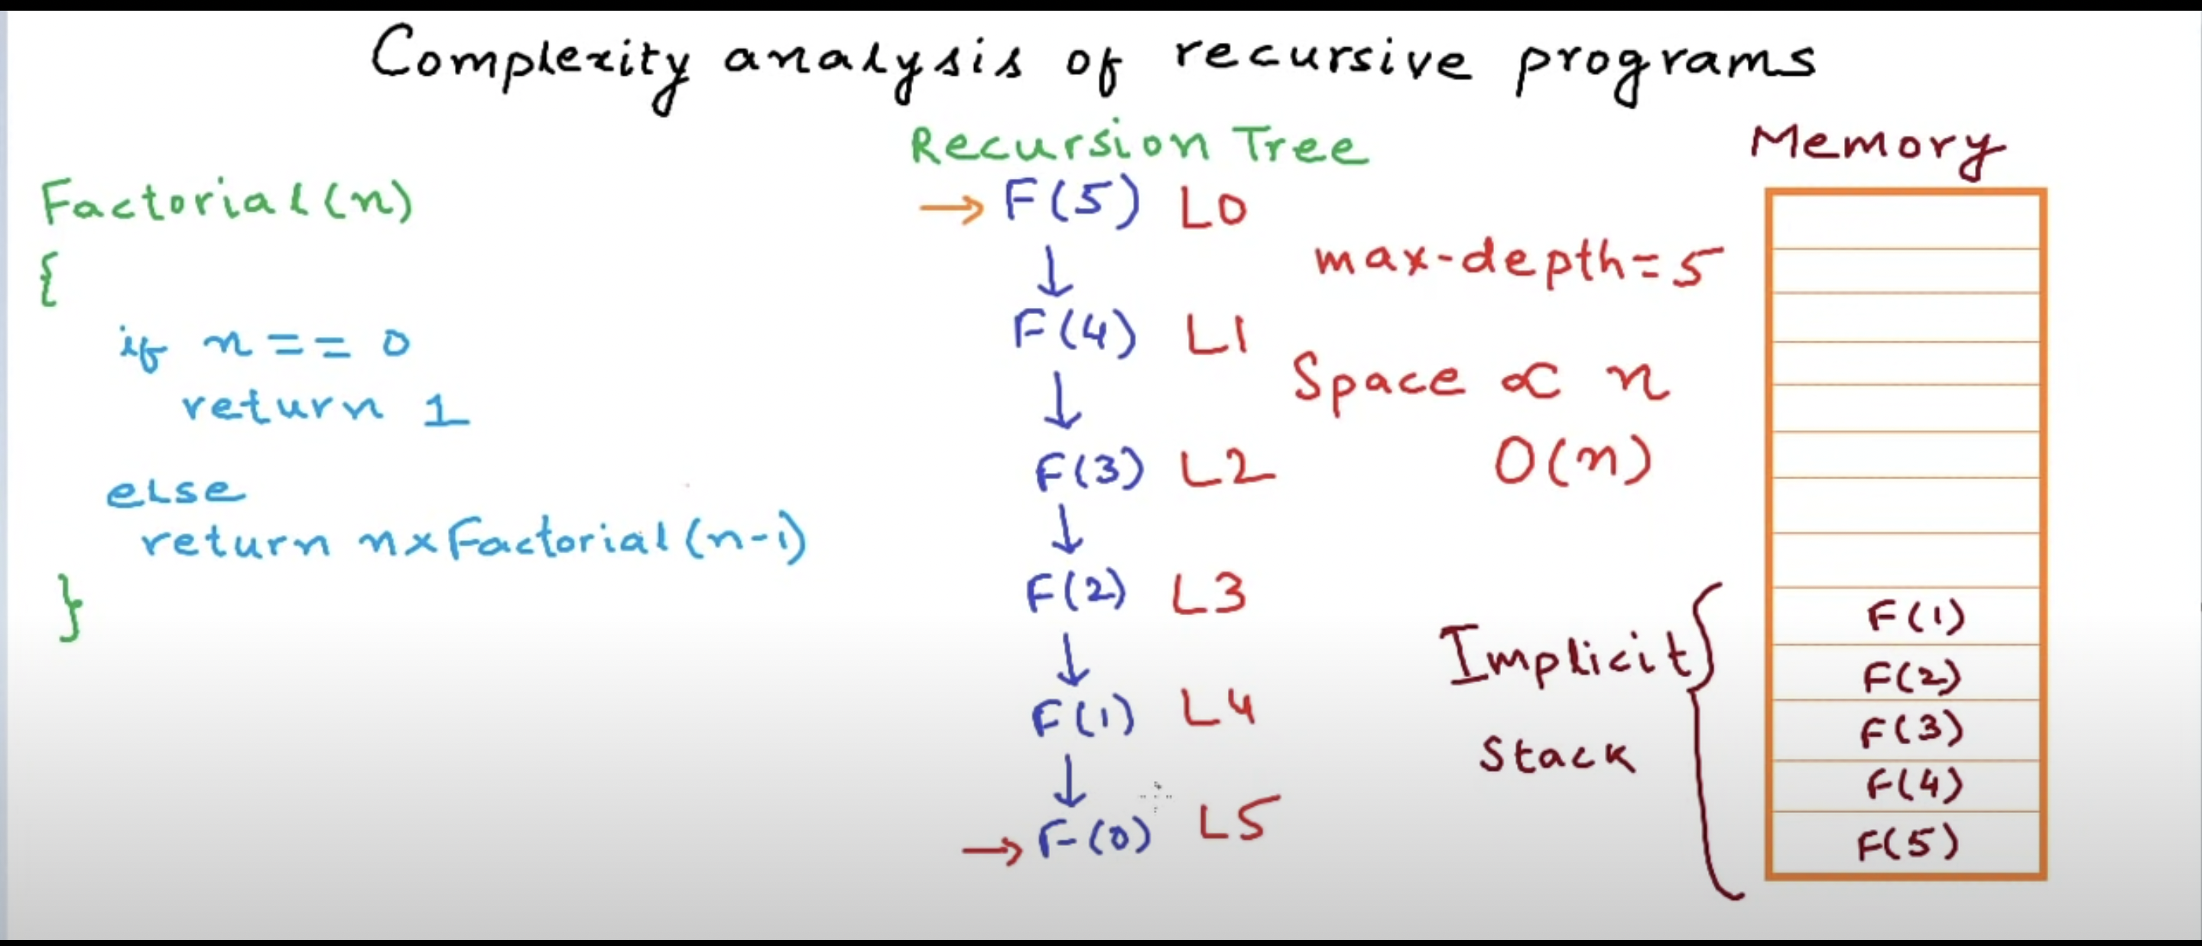

Slide 17
Asymptotic Notations
Following are the commonly used asymptotic notations to calculate the running time complexity of an algorithm.
1. Big-O (oh) Notation | Used to represent the Worst case.
2. Big-Ω (Omega) Notation | Used to represent the Best case
3. Big- θ (Theta) Notation | Used to represent the Average case

Slide 18
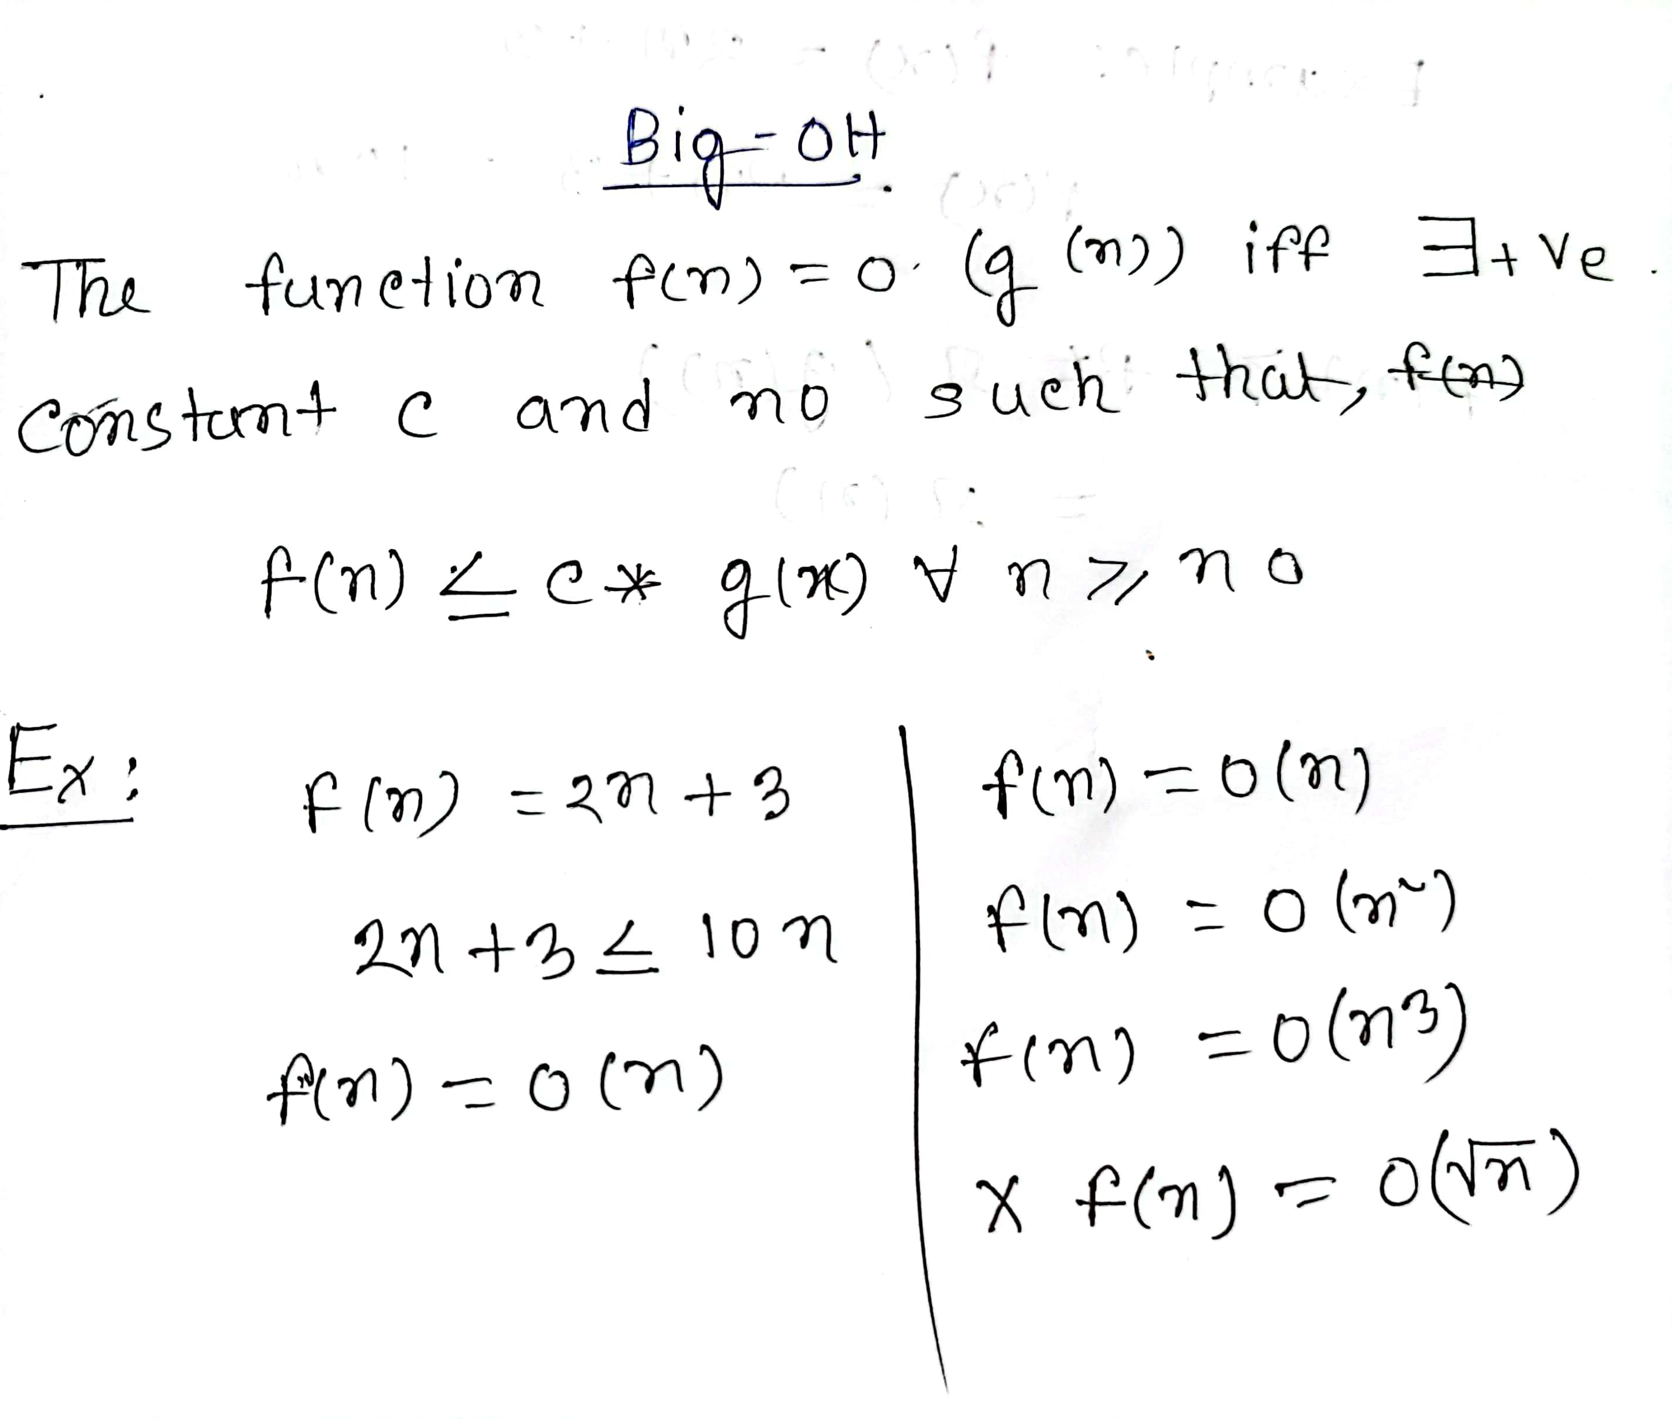

Slide 19
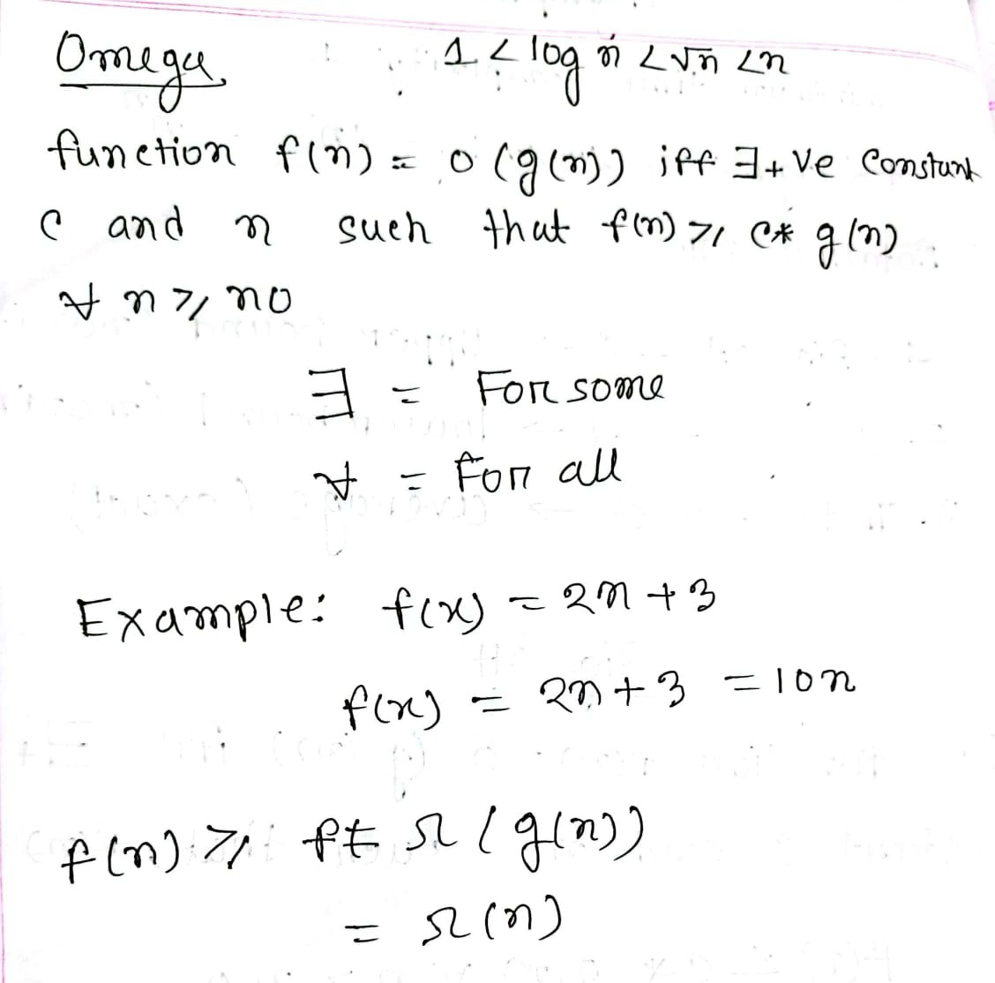

Slide 20
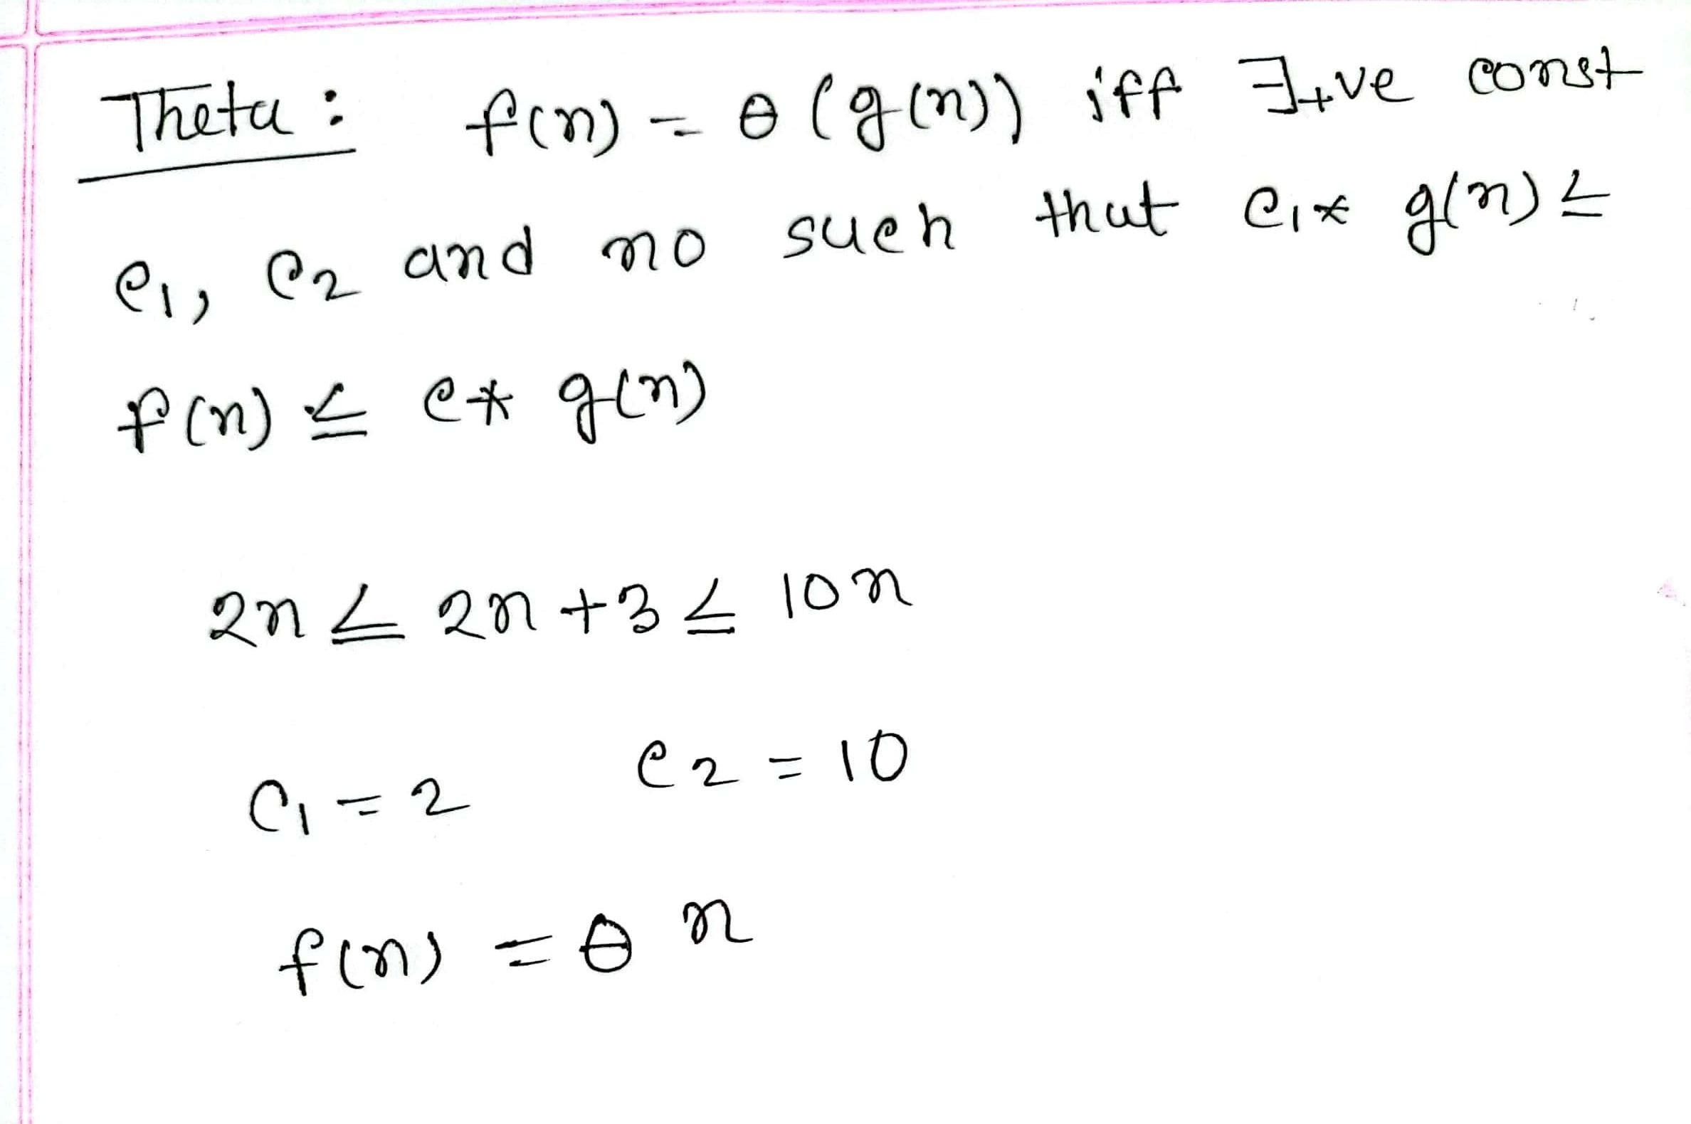

Slide 21
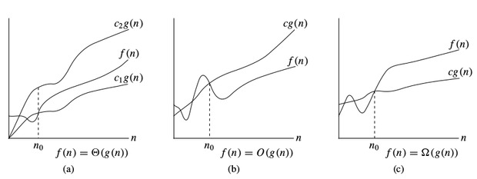

Slide 22
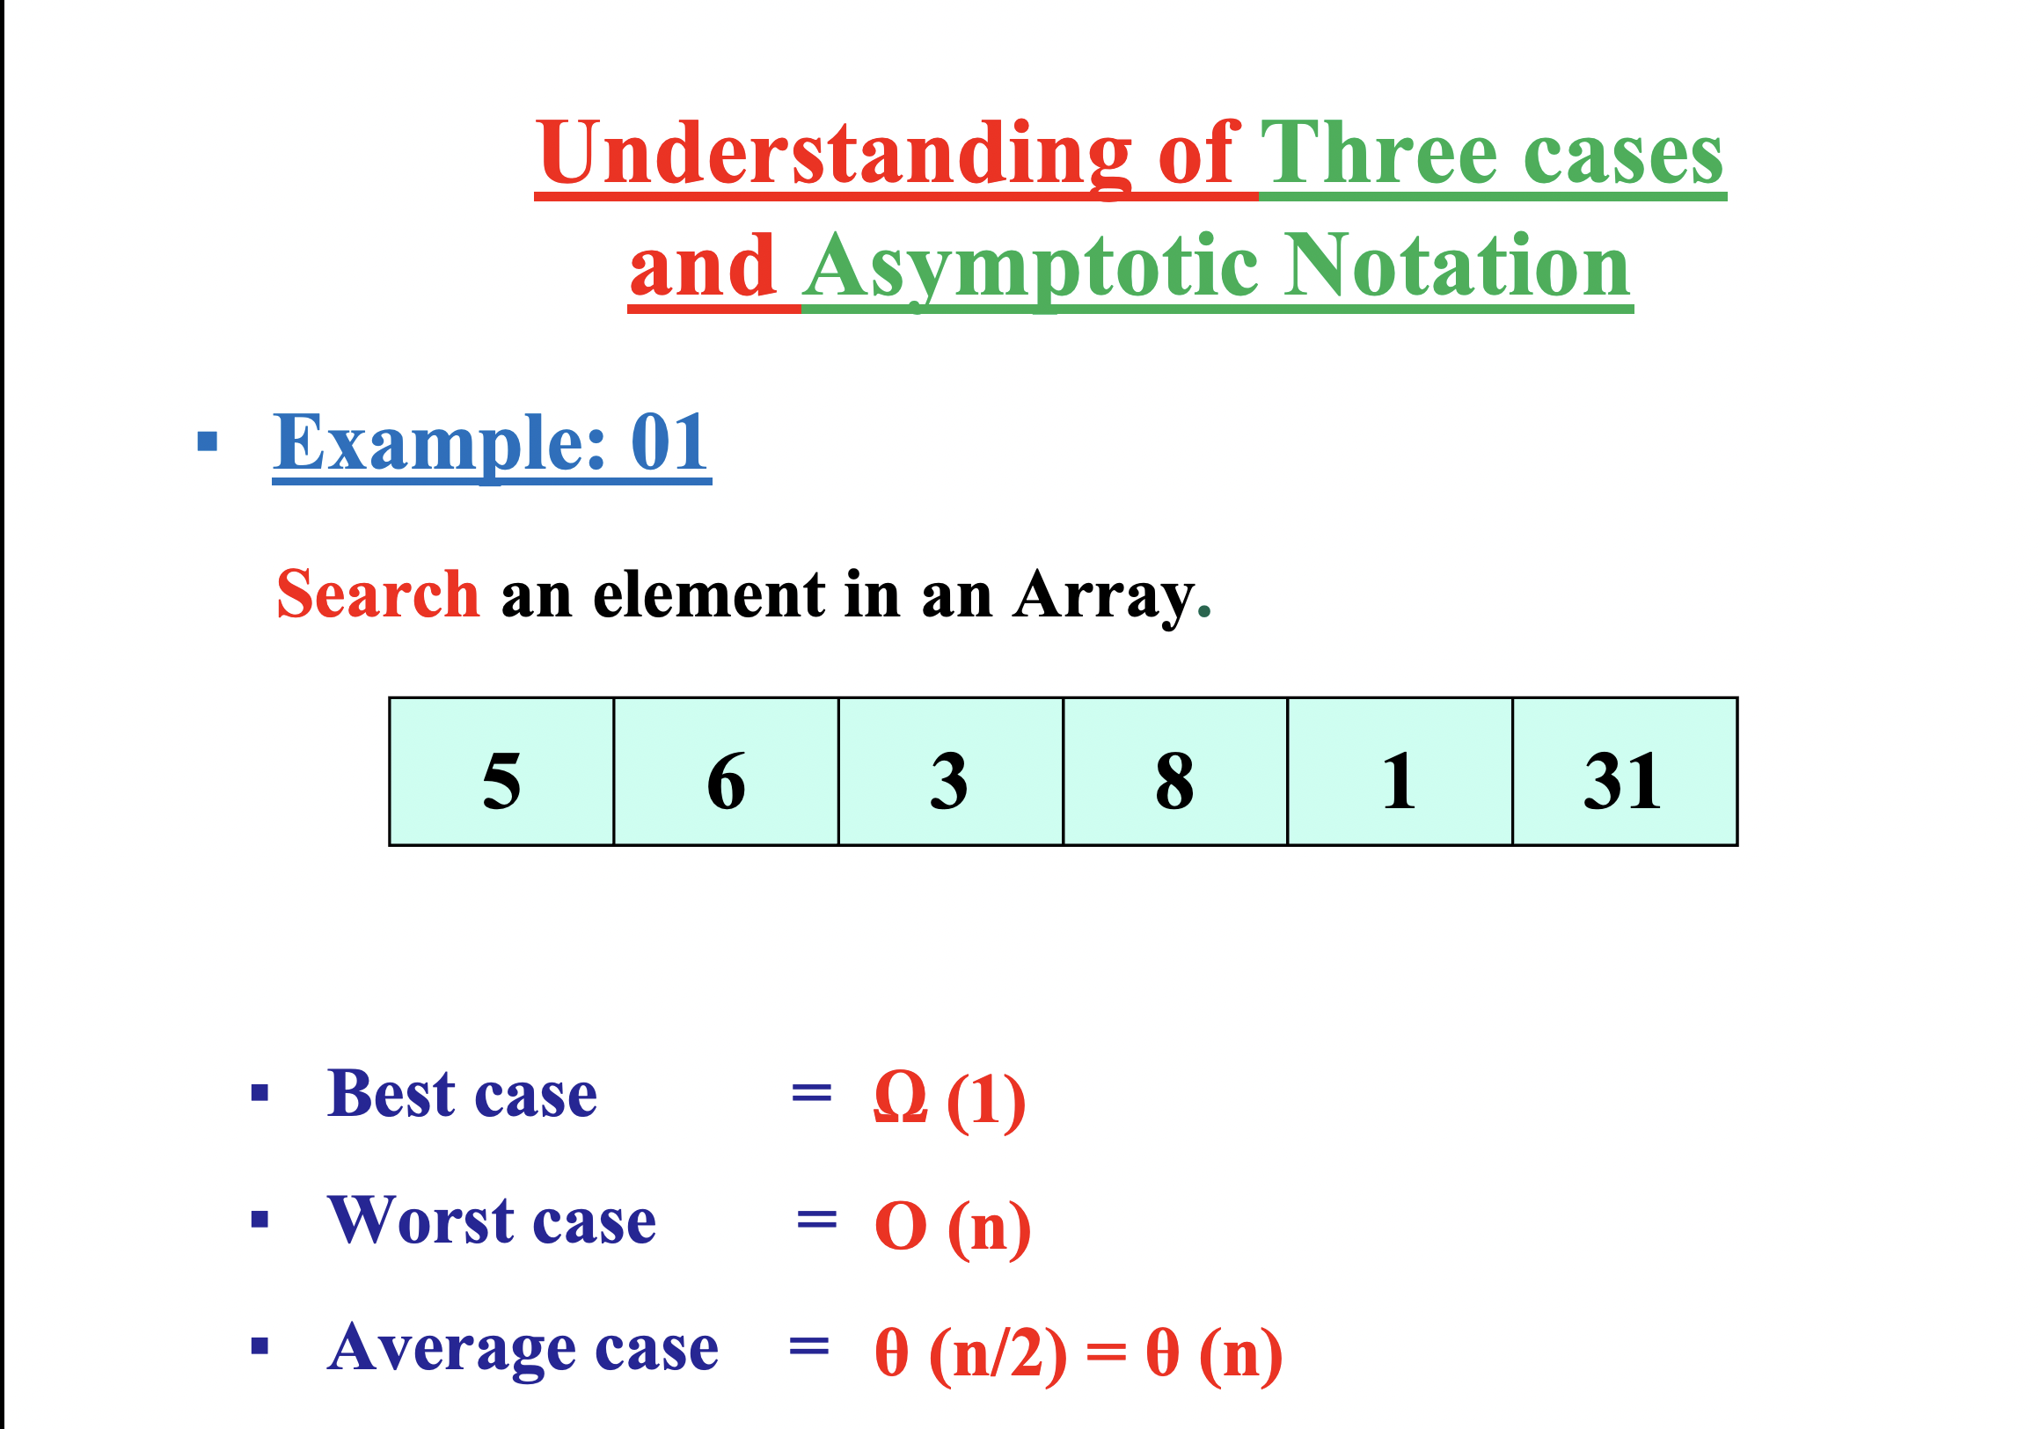

Slide 23


